Slide 1


Dual enrollment
Student & Parent Presentation

Slide 2

What is Dual Enrollment?
Dual Enrollment (DE) is a program where Georgia students enrolled in grades 10-12 can earn high school course credits while taking college courses.
DE is available for all 11th and 12th grade students and some 10th grade students meeting certain criteria.
  10th Grade students can take all CTAE classes at Technical Schools.
  10th Grade students meeting Zell Miller Requirements (1200 SAT or 25 ACT + 3.7 GPA) can take core classes.
Student can take up to 30 hours of college courses for Free!

Slide 3
Financial Considerations
What is covered?
Books
Tuition
Mandatory Fees
What is not covered?
Course related fees (if any)
i.e. Lab Fees or Online Fees
Expenses for travel or living on campus

Slide 4
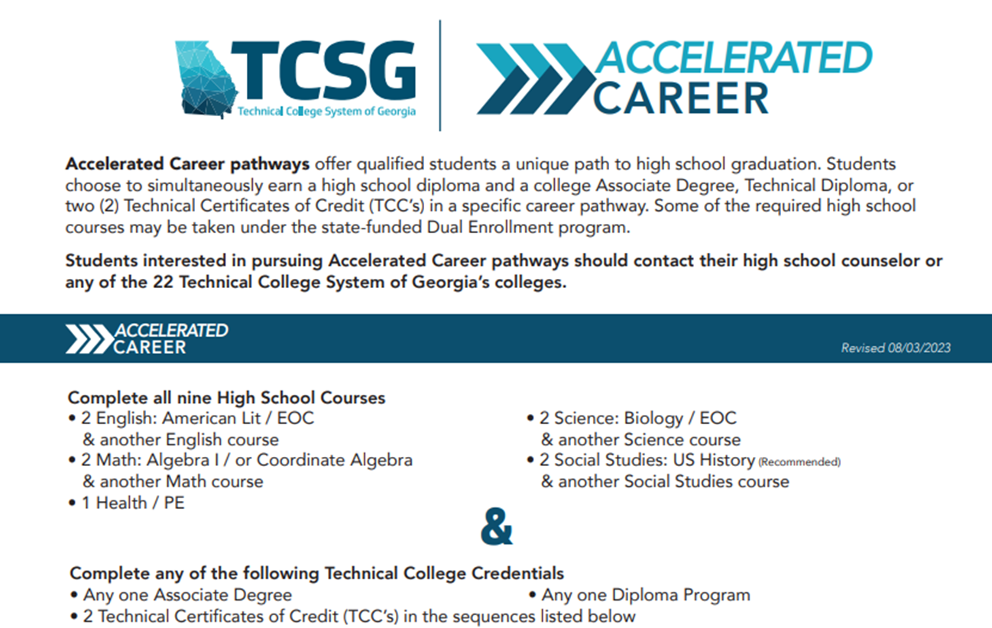
Accelerated Career
(formerly known as “Option B”)

Slide 5
How do I get this process started?
(Responsibilities of Students & Parents)
Decide which college to attend?
Most of our students choose the below schools, but you are not limited to these:
Chattahoochee Technical College
Georgia Highlands College
Georgia Military College
Kennesaw State University
University of West Georgia
Research!
Admissions requirements at postsecondary school of choice.
Do you want to be Full Time DE, Part-Time DE?
Schedule and take entrance exam
SAT, ACT, or Accuplacer.
This depends on the school.
Apply and get accepted to the college.
Do not wait until the day before the deadline to do this! You may not be able to see your counselor that quickly!

Slide 6
How do I get this process started?
(Responsibilities of Students & Parents)
Attend DE Information Night or watch narrated PowerPoint on the District Website.
This is done after the student is admitted to the college.
Meet with your Counselor
Set-up a meeting with your counselor to complete the DE paperwork that you started after the DE Information Night or watching the Narrated PowerPoint.
Complete GSFC DE Funding application and then Sign up for your college classes
Signing up for classes is done by the student/parent after consulting the counselor.
The Counselor will Accept the Funding Application from the College
During this process is where the student and parent complete the paperwork:
DE Participation & Advisement Agreement, Form 1
DE Advisement Agreement (per semester)
You are good to go after this!
Complete the Georgia Student Finance Commission DE Application. (this is on line on the GA Futures website)

Slide 7
Important considerations
Consider your students academic and emotional maturity when making the decision.
Speak with your high school counselor before making any changes to your college schedule. Failure to do so may result in an F, a 69 numeric grade on the student’s transcript for the dropped/changed course.
Contact high school counselor for participating in DE for the following semester.
Adhere to set deadlines of postsecondary institution and school district.

Slide 8

DE GSFC application ON Gafutures www.gafutures.org
The DE Application is completed in three sequential steps
Section 1: The student completes a DE application at www.GAfutures.org, online or prints the pdf version. Student must have a working GAfutures account with a working email.
Section 2: The participating high school or home study program must certify the student’s application and list the courses the student is planning to pursue for dual credit
Section 3: The participating postsecondary institution must certify the student’s application and approve the postsecondary courses for DE ‒ Sequence applies to both the electronic and paper DE applications
Located on DE webpage on GAfutures
Online version to be completed by eligible public and private high school students
DE Applications are term specific ‒ Must submit an application for each postsecondary semester or quarter of participation in the DE Program
Application provides for up to six courses per term

Slide 9
DE Paperwork
DE Student & Parent Acknowledgement Form
  Must be done first and is good for the current academic year.
  This includes the “Dual Enrollment Course Planning Form” that must be updated each semester.
DE District Exceptions
  This is for any DE exceptions:
    More than 12 hours of course credit in a semester.
    More than 4.0 credits in a semester.
    Self-Pay Courses (once you max out 30 hours)

Slide 10
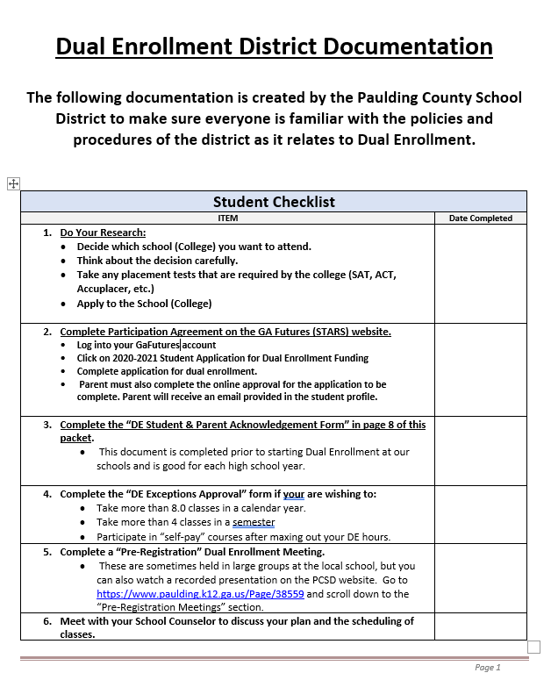
DE District Documentation pg. 1- Checklist

Slide 11
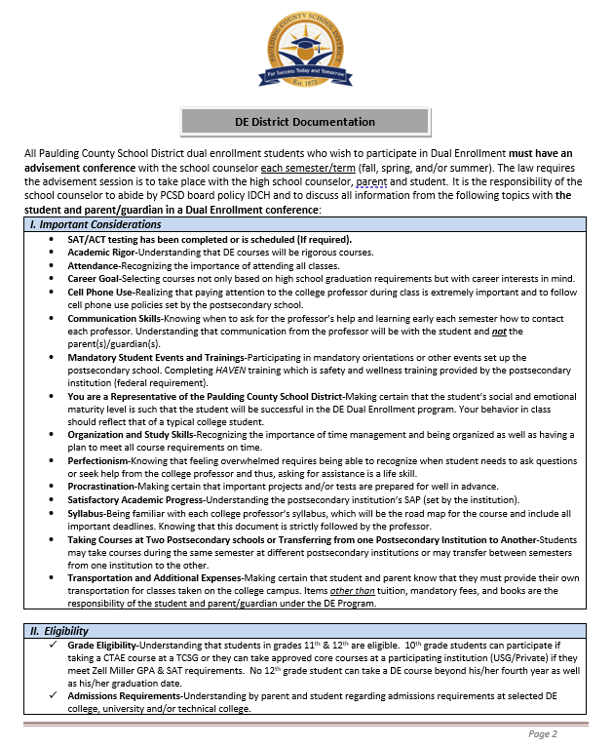
DE District Documentation pg. 2- Considerations & Eligibility

Slide 12
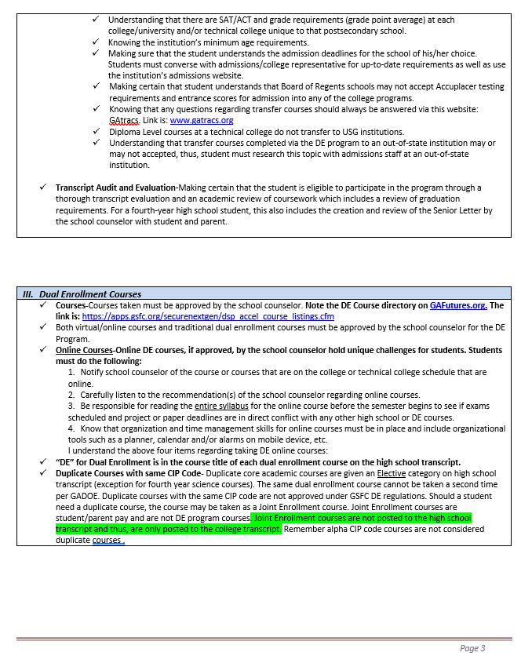
DE District Documentation pg. 3- Eligibility & Dual Enrollment Courses

Slide 13
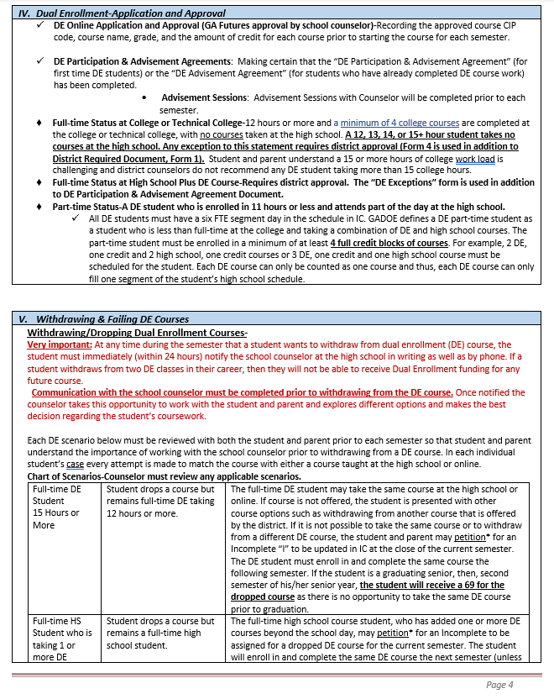
DE District Documentation pg. 4- Application & Approval, Withdrawing and failing a DE Course

Slide 14
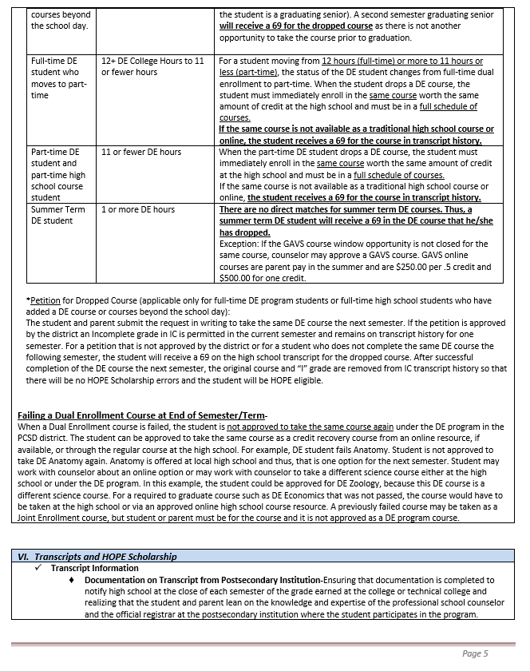
DE District Documentation pg. 5: Withdrawing & Failing a DE Course, Transcripts and HOPE Scholarship

Slide 15
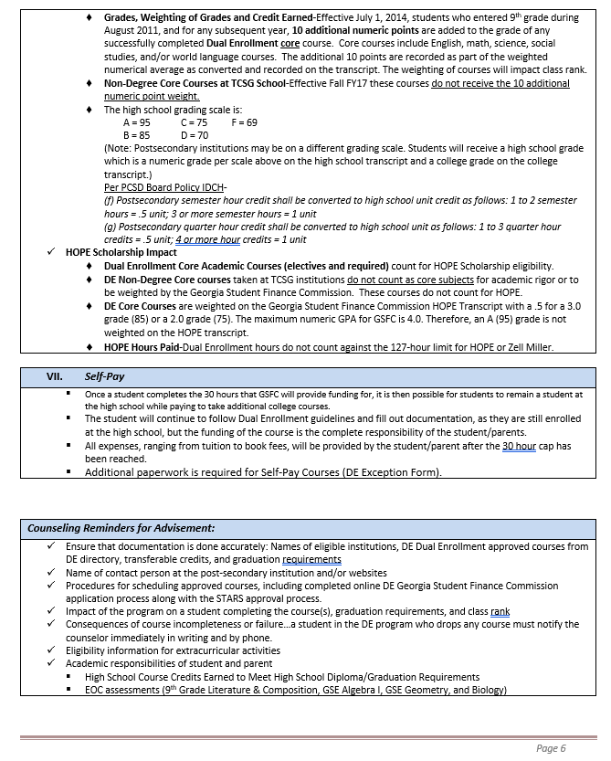
DE District Documentation pg. 6: Transcripts & Hope, Self-Pay, Reminders for Counselors

Slide 16
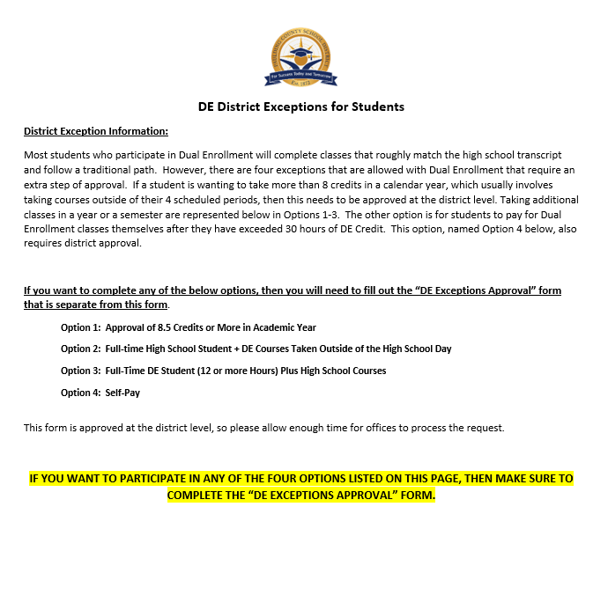
DE District Documentation pg. 7: DE District Exceptions explanation.
If this applies to you, there is additional paperwork to complete. Please see your counselor to work through this.

Slide 17
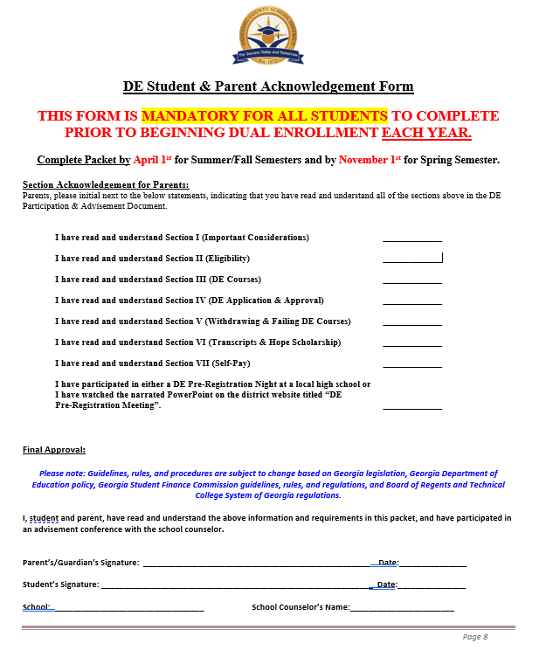
DE District Documentation pg. 8: DE Student & Parent Acknowledgement Form
Note that this page requires multiple parent & student initials and signatures.

Slide 18
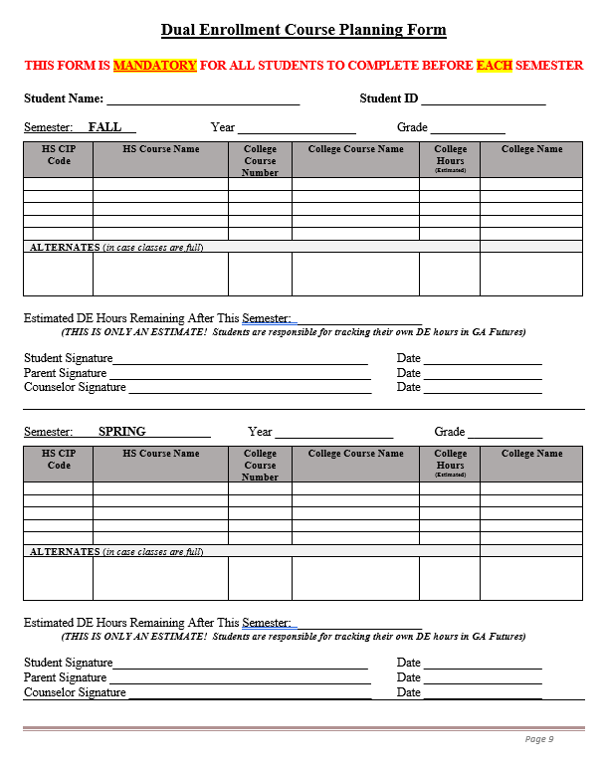
DE District Documentation pg. 9: DE Course Planning Form (Completed each semester)
Note that this page requires multiple parent & student initials and signatures.

Slide 19
DE District Exceptions for Students
You may ask for approval for exceptions to the following DE rules:
Option 1:
Approval of 8.5 Credits or More in an Academic Year.
Option 2:
Full-Time HS Student + DE Courses taken outside of the school day.
Option 3:
Full-Time DE Student (12+ hrs) plus High School Courses.
Note: These require District Approval. See your counselor for the extra paperwork if this is something that you are interested in.
Option 4:
Self-Pay for DE Courses after the 30 hour maximum has been hit.

Slide 20
DE on High School Campuses
There are some situations where certain schools are approved to have DE courses on their campus.
This occurs when the High School teacher is also approved to be a College Teacher with a particular College.
Examples:
  DE Healthcare, Hiram High School (Salina Hake)
  PCCA DE Courses
    Possibly ENGL 1101, PSYC, SOCI (based on interest)
    CNA PCT, Mechatronics (These are certificate programs offered by CTC)

Slide 21
Paulding virtual academy & Dual Enrollment
PVA Contact Information:
PVA Application Process for each school year will open around April 1st.
PVA Students can take Dual Enrollment courses!
  Must meet Post-Secondary school's application requirements
DE courses may be traditional or online courses.
High school PVA courses are online.
Phone: 770-445-2656
Dr. Vladimir Labossiere
vlabossiere@paulding.k12.ga.us

Slide 22
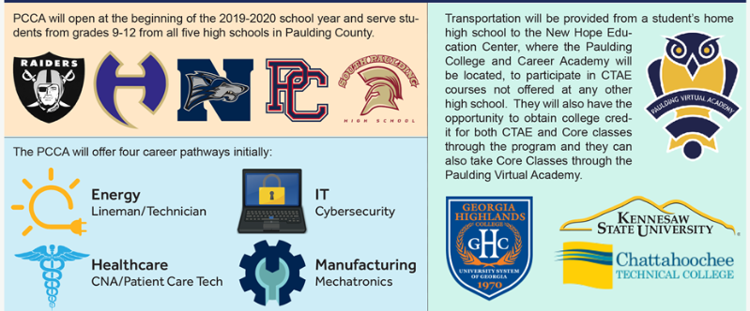
Paulding College & Career Academy & DE
What is PCCA?
The Paulding College & Career Academy offers four unique pathways that are available to any student in the PCSD.
Students can take PCCA courses and DE courses either online or there at the Academy.

Slide 23
Where Can I get more information?
Your local High School Counselor.
DE Course Directory:
    https://apps.gsfc.org/securenextgen/dsp_accel_course_listings.cfm
    This lists every course that is offered at each college and during each term.
District Counseling Website:
    https://counseling.paulding.k12.ga.us/index.php/academic/dual-enrollment/
Georgia Futures :
    www.gafutures.org
    This is where you fill out the funding application, see your HOPE GPA, etc.

